Slide 1
Process Synchronization
The Critical-Section Problem
Peterson’s Solution
Synchronization Hardware
Mutex Locks
Semaphores
Classic Problems of Synchronization
Monitors

Slide 2
Producer
while (true)
{
/* produce an item and put in nextProduced */
while (counter== BUFFER_SIZE)
; // do nothing
buffer [in] = nextProduced;
in = (in + 1) % BUFFER_SIZE;
counter++;
}

Slide 3
Consumer
while (true)
{
while (counter == 0)
; // do nothing
nextConsumed = buffer[out];
out = (out + 1) % BUFFER_SIZE;
counter--;
/* consume the item in nextConsumed
}

Slide 4
Race Condition
counter++ could be implemented as register1 = counter register1 = register1 + 1 counter = register1
counter-- could be implemented as register2 = counter register2 = register2 - 1 counter = register2

Slide 5
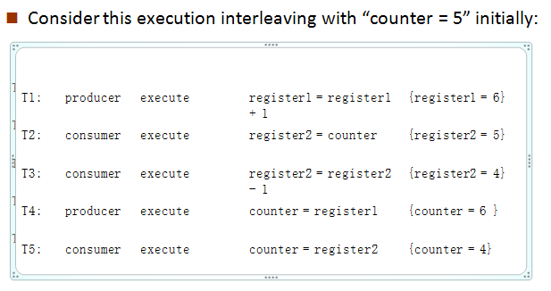
Race Condition

Slide 6
Critical section problem
Critical section – segment of code
changing common variables
Updating a table
Writing a file etc.
Entry section
Exit section
Remainder section

Slide 7
Critical section problem
do
{
critical section
remainder section
}while (TRUE);
Figure: General structure of a typical process P_{i}
Entry section
Exit section

Slide 8
Solution to Critical-Section Problem
1. Mutual Exclusion - If process P_{i} is executing in its critical section, then no other processes can be executing in their critical sections
Progress - If no process -critical section
some process - enter their critical section,
selection cannot be postponed indefinitely
3.Bounded Waiting - A bound must exist on the number of times that other processes are allowed to enter their critical sections

Slide 9
Ex:
Kernel – maintaining list of open files
Approaches to handle critical section in OS:
Preemptive kernels: allows a process to be preempted while it is running in kernel mode
Ex: Linux 2.6 kernel
Nonpreemptive kernels: does not allow a process running in kernel mode to be preempted
Ex: Windows XP, Windows 2000

Slide 10
Peterson’s Solution
s/w based solution to critical-section problem
Two process solution – P_{i} & P_{j}
The two processes share two variables:
int turn; → indicates whose turn it is to enter the critical section.
boolean flag[2] → indicates if a process is ready to enter the critical section
flag[i] = true ➔ process P_{i} is ready!

Slide 11
Algorithm for Process P_{i}
do {
flag[i] = TRUE;
turn = j;
while (flag[j] && turn == j);
critical section
flag[i] = FALSE;
remainder section
} while (TRUE);
Figure: Structure of process in P_{i} Peterson’s solution

Slide 12
1. How mutual exclusion is preserved?
P_{i} to enter into critical section: flag[j]=0
turn=i
2. If both P_{i} and P_{j} execute critical section at same time:
flag[0] = flag[1] = 1
turn = i or j → only one is possible

Slide 13
2. How progress requirement and bounded waiting requirements are satisfied?
P_{i} can be prevented from entering critical section if :
flag[j] = 1 & turn = j
If P_{j} is not ready to enter the critical section, then
flag[j] = 0
P_{i} can enter into critical section
If P_{j} has set flag[j] = 1 & executing remainder section, then turn = i or turn = j.
If turn = i ➔ P_{i} will enter critical section
If turn = j ➔ Pj will enter critical section

Slide 14
Synchronization Hardware
Solution to critical section problem requires a tool → lock
Critical regions protected by locks -> prevents race conditions
do
{
critical section
remainder section
} while (TRUE);
Uniprocessors : prevent interrupts from occurring while modifying shared variable.
Won’t work in multiprocessor environment because disabling interrupts is time consuming
acquire lock
release lock

Slide 15
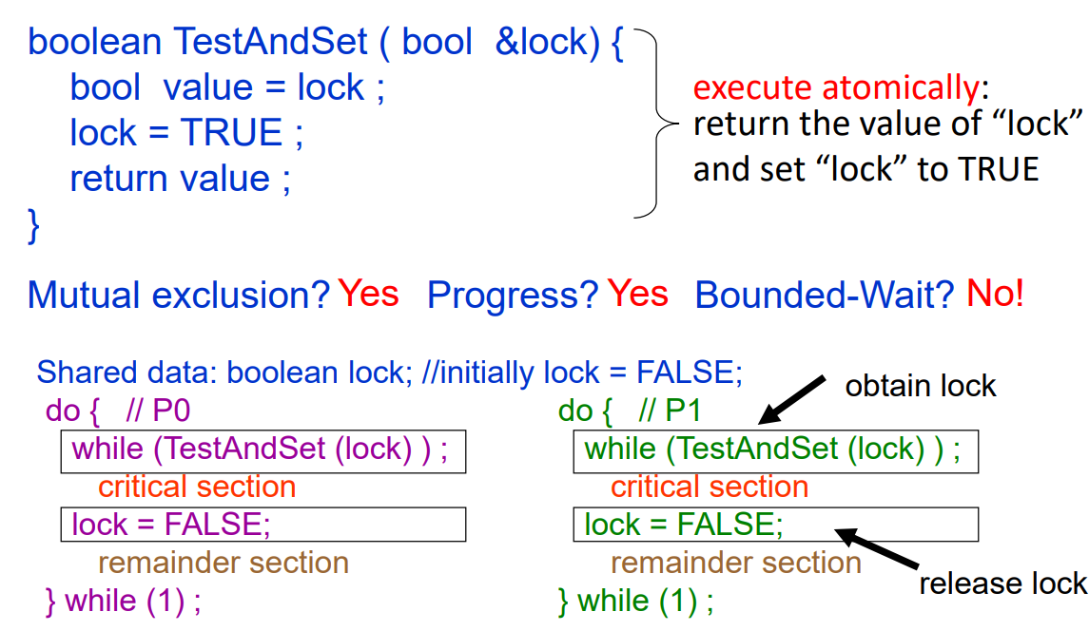
TestAndSet Instruction

Slide 16
Swap Instruction
Definition:
void Swap (boolean *a, boolean *b)
{
boolean temp = *a;
*a = *b;
*b = temp:
}

Slide 17
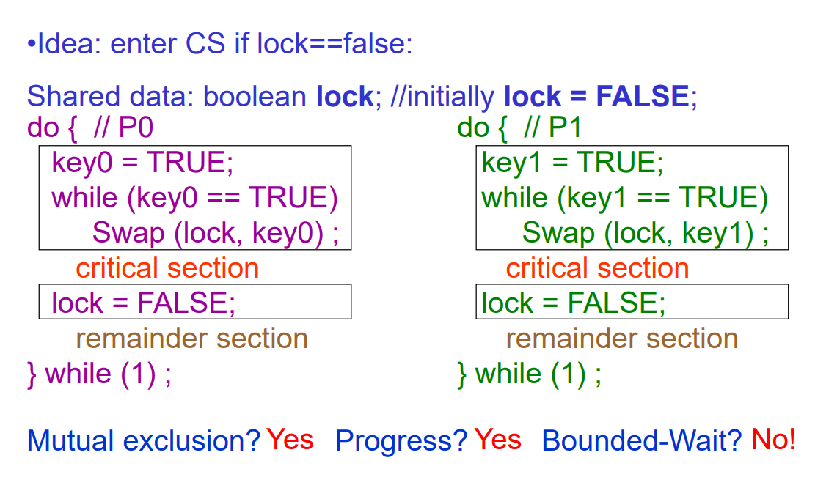
Solution using Swap
Shared Boolean variable lock initialized to FALSE; Each process has a local Boolean variable key

Slide 18
Bounded-waiting Mutual Exclusion with TestandTet()
do {
waiting[i] = TRUE;
key = TRUE;
while (waiting[i] && key)
key = TestAndSet(&lock);
waiting[i] = FALSE;
// critical section
j = (i + 1) % n;
while ((j != i) && !waiting[j])
j = (j + 1) % n;
if (j == i)
lock = FALSE;
else
waiting[j] = FALSE;
// remainder section
} while (TRUE);

Slide 19
Deadlock and Starvation in synchronization
Deadlock – two or more processes are waiting indefinitely for an event that can be caused by only one of the waiting processes
Let T and Q be two semaphores initialized to 1
P₀ P₁
wait (T); wait (Q);
wait (Q); wait (T);
. .
. .
. .
signal (T); signal (Q);
signal (Q); signal (T);
Starvation – indefinite blocking. A process may never be removed from the semaphore queue in which it is suspended
Priority Inversion - Scheduling problem when lower-priority process holds a lock needed by higher-priority process

Slide 20
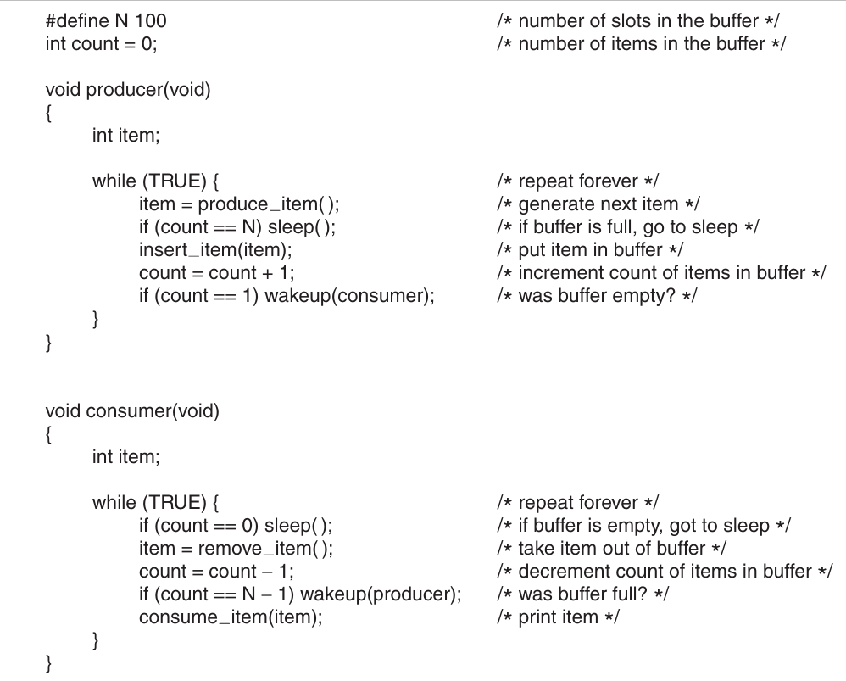
Producer consumer Problem
Source: Modern operating system-Tanenbaum

Slide 21
The essence of the problem here is that a wakeup sent to a process that is not (yet) sleeping is lost.
If it were not lost, everything would work. A quick fix is to modify the rules to add a wakeup waiting bit to the picture

Slide 22
Semaphore
Synchronization tool that does not require busy waiting
Semaphore S → integer variable
Two standard operations modify S: wait() and signal()
Originally called P() and V()
Less complicated
Can only be accessed via two indivisible (atomic) operations
wait (S)
{
while S <= 0
; // no-op
S--;
}
signal (S)
{
S++;
}

Slide 23
Semaphore as General Synchronization Tool
Counting semaphore – integer value can range over an unrestricted domain
Binary semaphore – integer value can range only between 0 and 1; can be simpler to implement
Also known as mutex locks
Can implement a counting semaphore T as a binary semaphore
Provides mutual exclusion
semaphore mutex; // initialized to 1
do {
wait (mutex);
// Critical section
signal (mutex);
// remainder section
} while (TRUE);

Slide 24
Semaphore Implementation
Must guarantee that no two processes can execute wait () and signal () on the same semaphore at the same time
Thus, implementation becomes the critical section problem where the wait and signal code are placed in the critical section.
Could now have busy waiting in critical section implementation
But implementation code is short
Little busy waiting if critical section rarely occupied
Note that applications may spend lots of time in critical sections and therefore this is not a good solution.

Slide 25
Semaphore Implementation with no Busy waiting
With each semaphore there is an associated waiting queue. Each entry in a waiting queue has two data items:
value (of type integer)
pointer to next record in the list
Two operations:
block – place the process invoking the operation on the appropriate waiting queue.
wakeup – remove one of processes in the waiting queue and place it in the ready queue.
typedef struct {
int value;
struct process *list;
}semaphore;

Slide 26
Semaphore Implementation with no Busy waiting (Cont.)
Implementation of wait:
wait(semaphore *S) {
S->value--;
if (S->value < 0) {
add this process to S->list;
block();
}
}
Implementation of signal:
signal(semaphore *S) {
S->value++;
if (S->value <= 0) {
remove a process P from S->list;
wakeup(P);
}
}

Slide 27
Classical Problems of Synchronization
Bounded-Buffer Problem
Readers and Writers Problem
Dining-Philosophers Problem

Slide 28
Bounded-Buffer Problem Solution Using Semaphore
n buffers, each can hold one item
Semaphore mutex initialized to the value 1
Semaphore full initialized to the value 0
Semaphore empty initialized to the value n
Count the no. of full & empty buffers

Slide 29
Bounded Buffer Problem (Cont.)
The structure of the producer process:
do { // produce an item in nextp
wait (empty);
wait (mutex);
// add the item to the buffer
signal (mutex);
signal (full);
} while (TRUE);
The structure of the consumer process
do {
wait (full);
wait (mutex);
// remove an item from buffer to nextc
signal (mutex);
signal (empty);
// consume the item in nextc
} while (TRUE);

Slide 30
Readers-Writers Problem
A data set is shared among a number of concurrent processes
Readers – only read the data set; they do not perform any updates
Writers – can both read and write
Problem – allow multiple readers to read at the same time. Only one single writer can access the shared data at the same time
Variations:
1. no reader be kept waiting unless a writer has already obtained permission to use the shared object.
2. if a writer is waiting to access the object, no new readers may start reading.
A solution to either problem may result in starvation. In the first case, writers may starve; in the second case, readers may starve.
Shared Data
Data set
Semaphore mutex initialized to 1
Semaphore wrt initialized to 1 // Mutual exclusion semaphore WRITER
Integer readcount initialized to 0 // How many process reading the data
semaphore mutex, wrt;
int readcount;

Slide 31
Readers-Writers Problem (Cont.)
Writer process:
do {
wait (wrt) ;
// writing is performed
signal (wrt) ;
} while (TRUE);
Reader process:
do {
wait (mutex) ;
readcount ++ ;
if (readcount == 1)
wait (wrt) ;
signal (mutex)
// reading is performed
wait (mutex) ;
readcount - - ;
if (readcount == 0)
signal (wrt) ;
signal (mutex) ;
} while (TRUE);

Slide 32
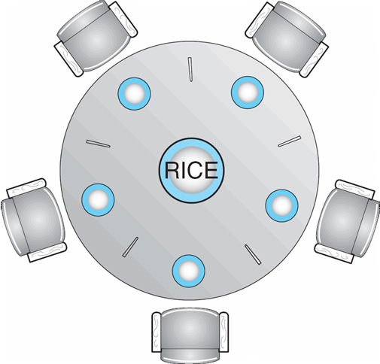
Dining-Philosophers Problem
Shared data
Bowl of rice (data set)
Binary Semaphore chopstick [5] initialized to 1

Slide 33
Dining-Philosophers Problem (Cont.)
The structure of Philosopher i:
do {
wait ( chopstick[i] );
wait ( chopstick[ (i + 1) % 5] );
// eat
signal ( chopstick[i] );
signal (chopstick[ (i + 1) % 5] );
// think
} while (TRUE);

Slide 34
Dining-Philosophers Problem (Cont.)
Remedies:
At most 4 philosophers
Pick only if both are available
Odd → first left, then right
even → first right, then left

Slide 35
Problems with Semaphores
Correct use of semaphore operations:
signal (mutex) …. wait (mutex)
wait (mutex) … wait (mutex)
Omitting of wait (mutex) or signal (mutex) (or both)

Slide 36
Monitors
mechanism for process synchronization
Only one process may be active within the monitor at a time
monitor monitor-name
{
// shared variable declarations
procedure P1 (…) { …. }
…
procedure Pn (…) {……}
Initialization code ( ….) { … }
…
}

Slide 37
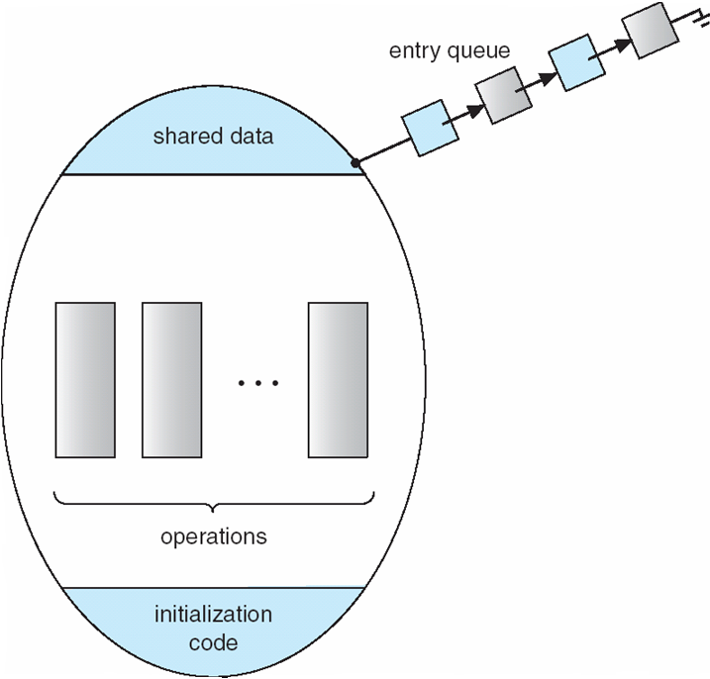
Schematic view of a Monitor

Slide 38
Monitor Implementation (using semaphores)
Need mutual exclusion semaphore mutex (init to 1) so that only one process is active within monitor
Need a semaphore next (next to exit) for the signaling process to suspend itself
initialized to zero
next_count is number of processes blocked on next
Before exiting a procedure, process must either:
Signal other waiting processes in monitor (next) before exiting, or
Signal mutex and exit

Slide 39
Monitor Implementation
Since only one task may be active in a monitor there must be a mutex protecting each method.
We also need to account for sending signals within a monitor – that is, guard against having more than one active task within the monitor.
Our implementation uses semaphores for both mutual exclusion (initialized to 1 for a mutex) and counting the number of tasks waiting to be resumed within the monitor (initialized to 0 – counting semaphore)

